Slide 1
HCP Patient & Dispense Performance Analysis
BizInsights Case Study Round
Shraddha S
Data Analyst
Date:04/12/2025

Slide 2
BUSINESS PROBLEM STATEMENT
Objective of the Case Study:
To analyze HCP enrollment, prescription behavior, satisfaction (NPS), and retention
To compare HCP performance across time (2021 vs 2022)
To identify high-performing specialties and experience groups
To generate insights for business decision-making

Slide 3
DATA OVERVIEW
Key Columns:
HCP Unique ID
Specialty
First & Last Dispense Dates
Enrollments
NPS
Discontinuations
Area & Active Status
Rx Duration & Buckets
Data Processing Steps:
Created unique HCP identifiers
Calculated Rx Duration in days
Created Rx Duration Buckets
Extracted Start Year (2021 & 2022)

Slide 4
KEY KPIs
Total Enrollments : 14,000+
Total HCPs: 392
Active HCP Rate: 71%
Average Enrollment per HCP: 35.72
Average NPS: 24.14
Total Discontinuations: 5,912

Slide 5
TOP BUSINESS INSIGHTS
AI specialty is the top contributor to total enrollments.
Mid-tenure HCPs (3–6 months) show the highest average enrollment.
Long-term HCPs (12+ months) form the largest active group.
2022 shows improved average NPS with strong enrollment performance.

Slide 6
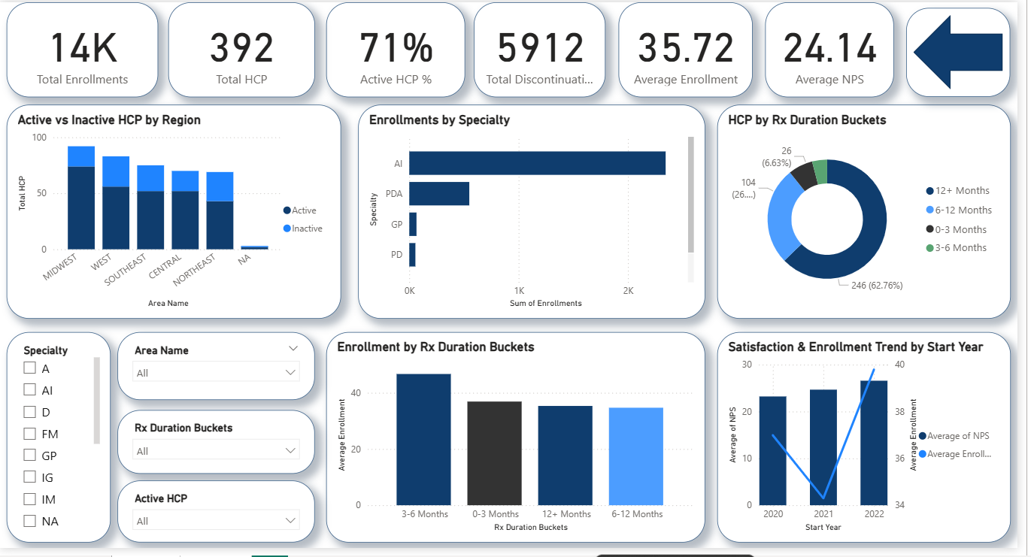
Interactive Power BI dashboard with filters for Specialty, Area, Rx Duration Buckets, and Active HCP status.

Slide 7
2021 vs 2022 COMPARISON
Metric | 2021 | 2022
Avg Enrollment | 34.30 | 34.76
Avg NPS | 24.67 | 26.57
Avg Discontinuations | 14.5 | 16.21
Active HCP % | 69% | 89%

Slide 8
CONCLUSION & BUSINESS VALUE
Improved HCP engagement strategies in 2022 led to higher satisfaction and activity.
Mid-duration HCPs are the most productive group.
AI & PDA specialties should be prioritized for future growth.
Dashboard enables data-driven decisions on onboarding, retention, and performance.

Slide 9
TOOLS & SKILLS USED
Excel: Data Cleaning, SUMIF, AVERAGEIF, Sorting, Bucketing
Power BI: DAX Measures, KPI Cards, Interactive Visuals, Slicers
Business Analysis & Data Storytelling

Slide 10
Thank You

